Slide 1
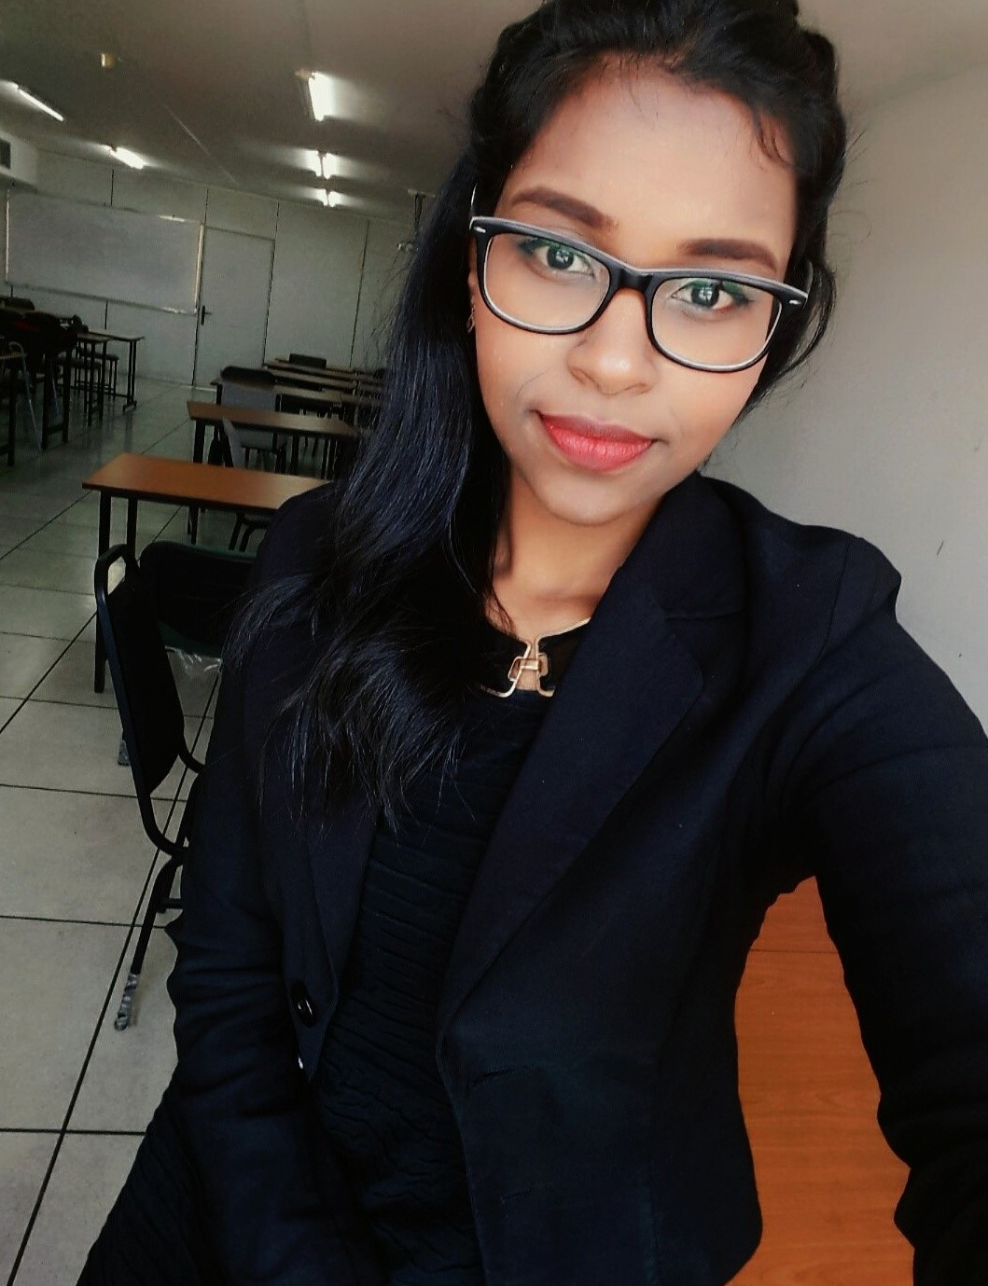

Areas of expertise
Experience
Functional
Full Stack
Azure Synapse
Industries
Gas Supply
Sales / Procurement
Microsoft BI Developer (Jan 2020 – To Date)
Create and manage BI and analytics solutions that turn data into knowledge.
Chitra Seedam
Technical
Azure DevOps
Azure Data Factory/ Data Pipelines
T-SQL
SQL Server
GIT
Power BI
Web (HTML5/CSS/JS)
jQuery
Bootstrap
REST / Web API
C-Sharp / ASP.NET
PHP
Java/ Android Studio
Microsoft BI Developer
Application Development Associate Ebène, Mauritius.
Education
Professional background
BSc(Hons) Web Technologies
University of Technology, Mauritius, 2017 – 2021
1+ year of experience in application development | Azure | Big Data | Agile
Coding is fun. Make it work, make it right, make it fast. Always willing to learn new technologies

Slide 2

PRODUCTS
Microsoft BI Developer
Skills & Technologies
Agile BI Project
Teams in Mauritius and France
Building an Agile BI Project form Scratch to create and manage BI and analytics solutions that turn data into knowledge
I am responsible for the following project activities:
Translate business needs to technical specifications
Design, build and deploy BI solutions
Maintain and support data analytics platforms
Create tools to store data (Cubes)
Conduct unit testing and troubleshooting
Evaluate and improve existing BI systems
Collaborate with teams to integrate systems
Develop and execute database queries and conduct analyses
Create visualizations and reports for requested projects
Develop and update technical documentation
Skills
Teamwork
Analysis & solutions design
Scrum
Agile
Technical
Azure Synapse
ETL
SSIS/ SSAS
T-SQL
SQL/ SSMS
GIT
Azure Data Factory/ Data Pipelines
Power BI

